Slide 1
Group 3:
Online Store Management System
Group members:
BSCS 17026
BSCS 17056
BSCS 17063
BSCS 17064
BSCS 17070
BSCS 17077

Slide 2
Introduction
Motivation
01
Our motivation for making an online store the motivation we had for shopping as ecommerce shoppers.
Front end
02
The front end uses languages like HTML, CSS, JavaScript, Bootstrap and JQuery.
Back end
03
At the back end we have PHP along with the database MYSQL .
Business Constraints
04
Our Website satisfies all business constraints

Slide 3
Technology Stack

Slide 4
Technology Stack
HTML
CSS
Further Design of the webpage using .
Simple web interface constructed on the basis of backend.
Interface
Life Cycle
Back End
JAVASCRIPT
Using PHP to enter/fetch data from the database MYSQL.
Java Script being used to .

Slide 5
Modes
User Mode
01
User mode allow user to buy products and use all functionalities
Admin Mode
02
Admin is allowed to add products, delete products etc
Guest Mode
03
Guest can only view products

Slide 6
Website Interface

Slide 7
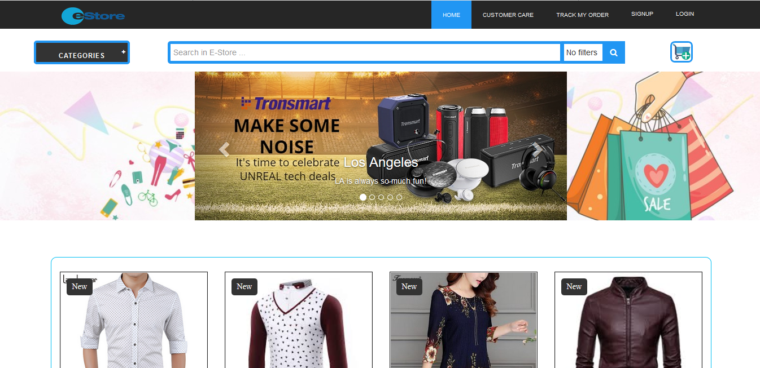
Guest Mode

Slide 8
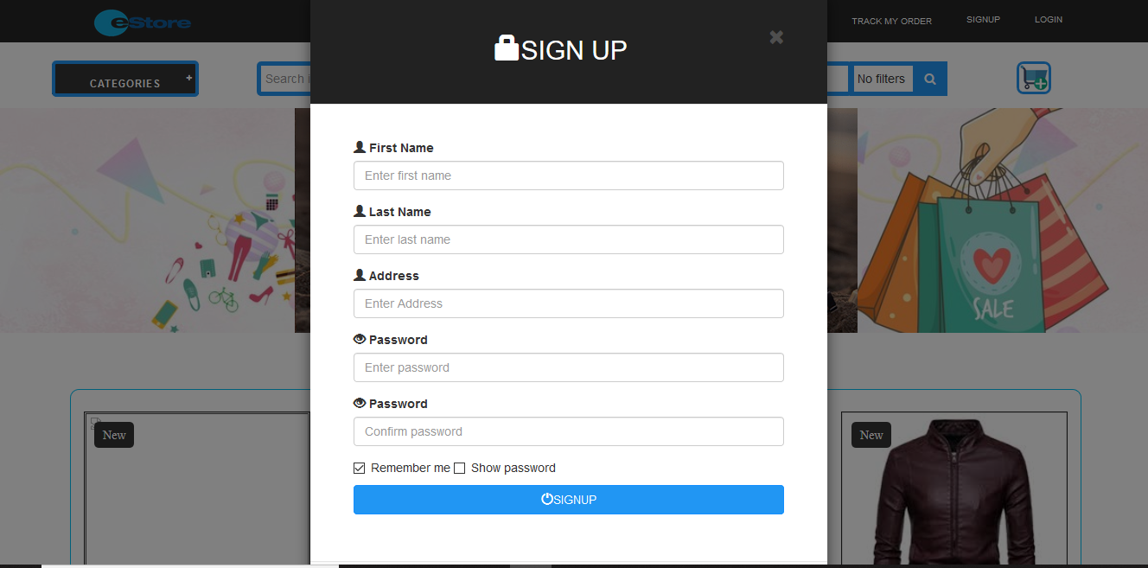
Guest Mode

Slide 9
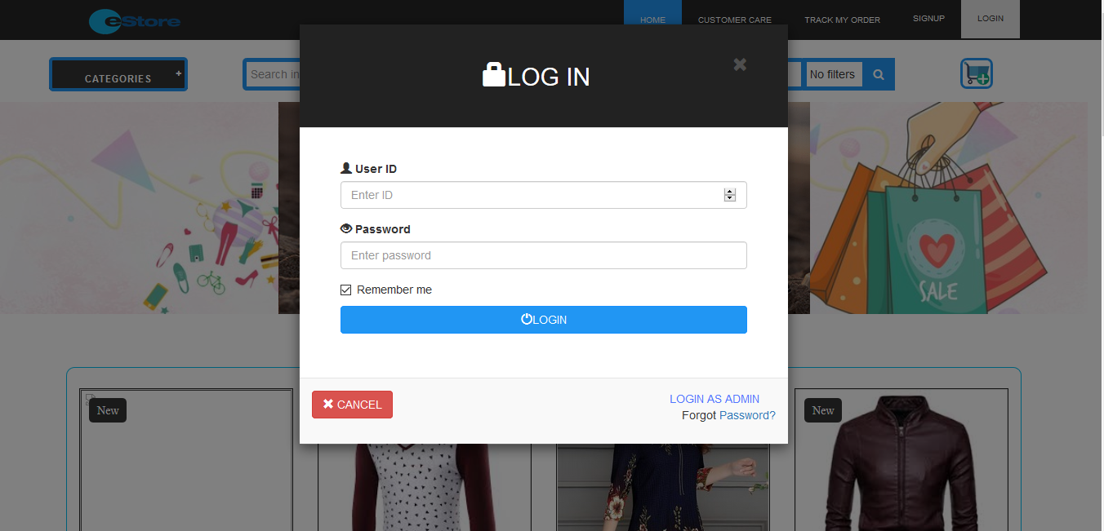
Login

Slide 10
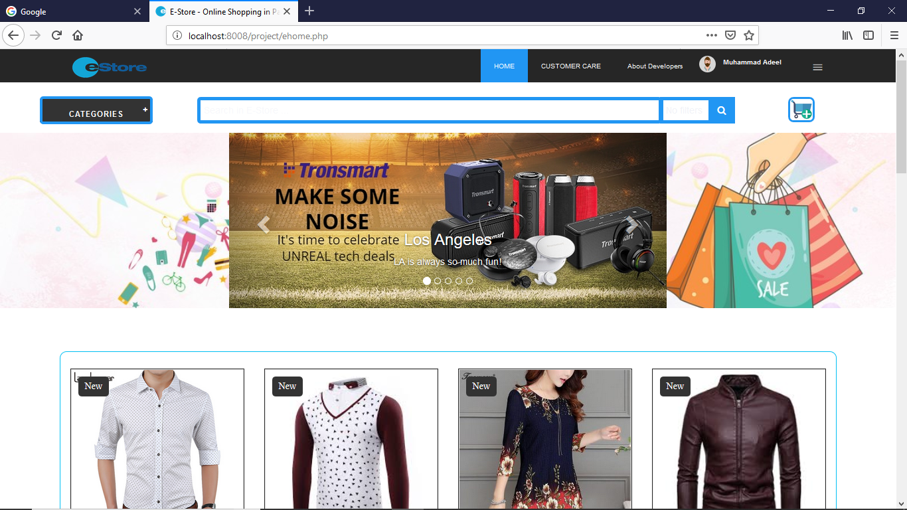
User Mode

Slide 11
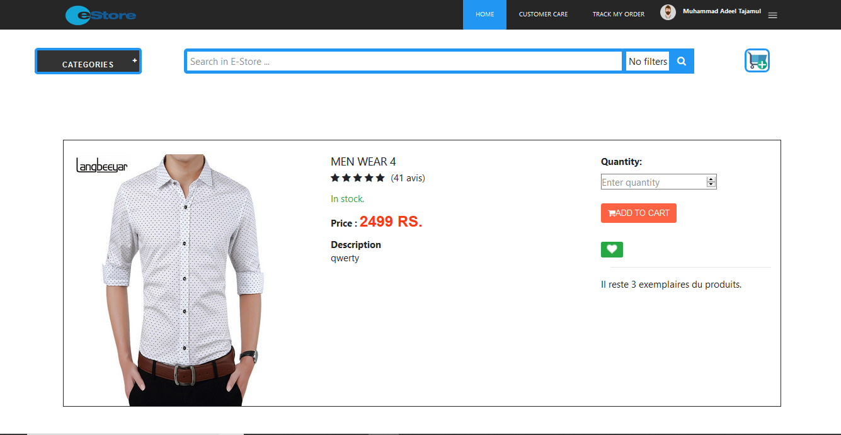
Product View

Slide 12
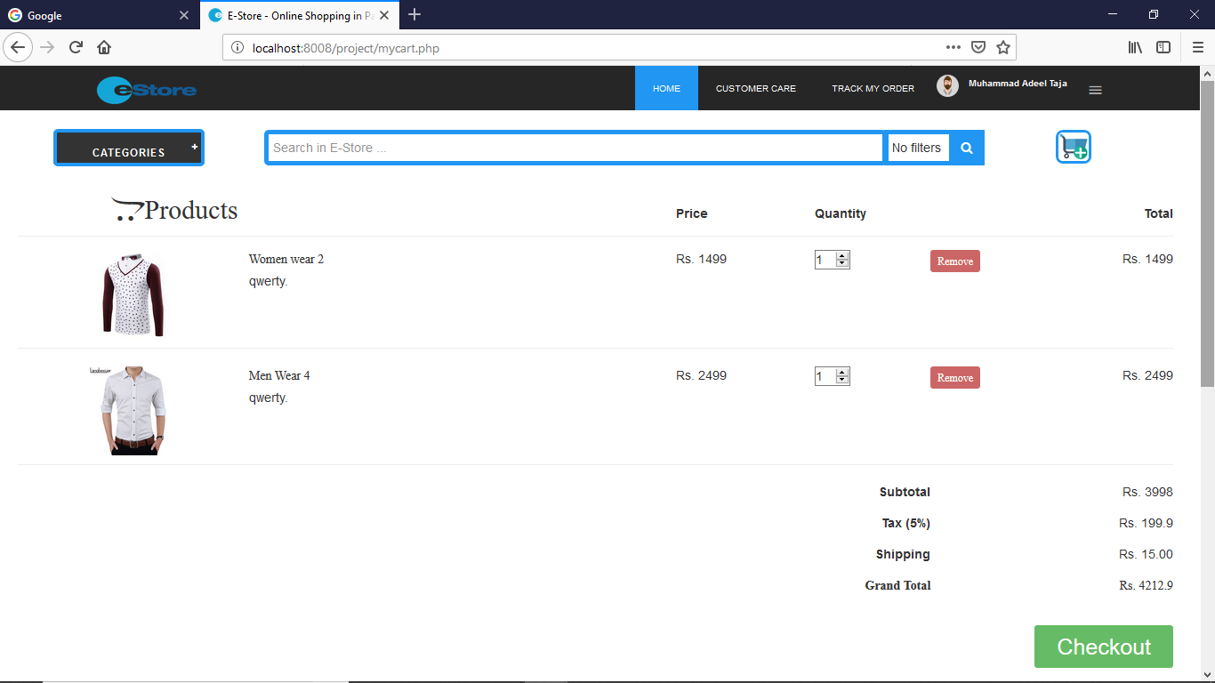
User Cart

Slide 13
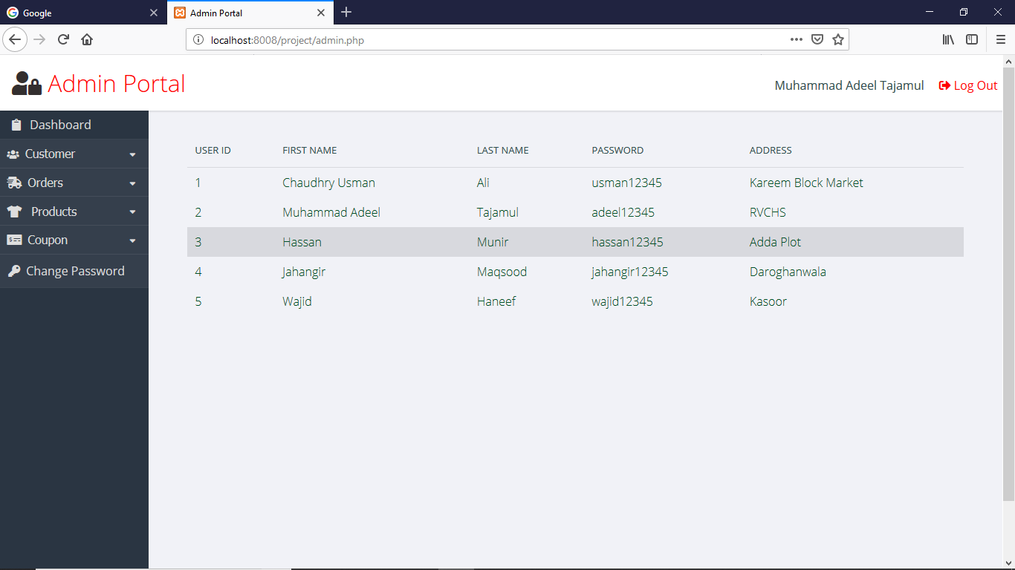
Admin Mode

